Slide 1
Lecture 10: Probability redux; recognizing distributions Maximum Likelihood (MLE) Kernel Density Estimation (KDE)
DS 4400: Machine Learning and Data Mining 1

Slide 2
Today
Today
Previously
Bernoulli
Categorical
Discrete Uniform
Poisson
Continuous Uniform
Exponential
Gaussian
Python and Practice

Slide 3
Probability distributions in Machine Learning
PMFs (for discrete variables) and PDFs (for continuous variables) describe how data is distributed.
Many ML models assume certain data distributions

Slide 4
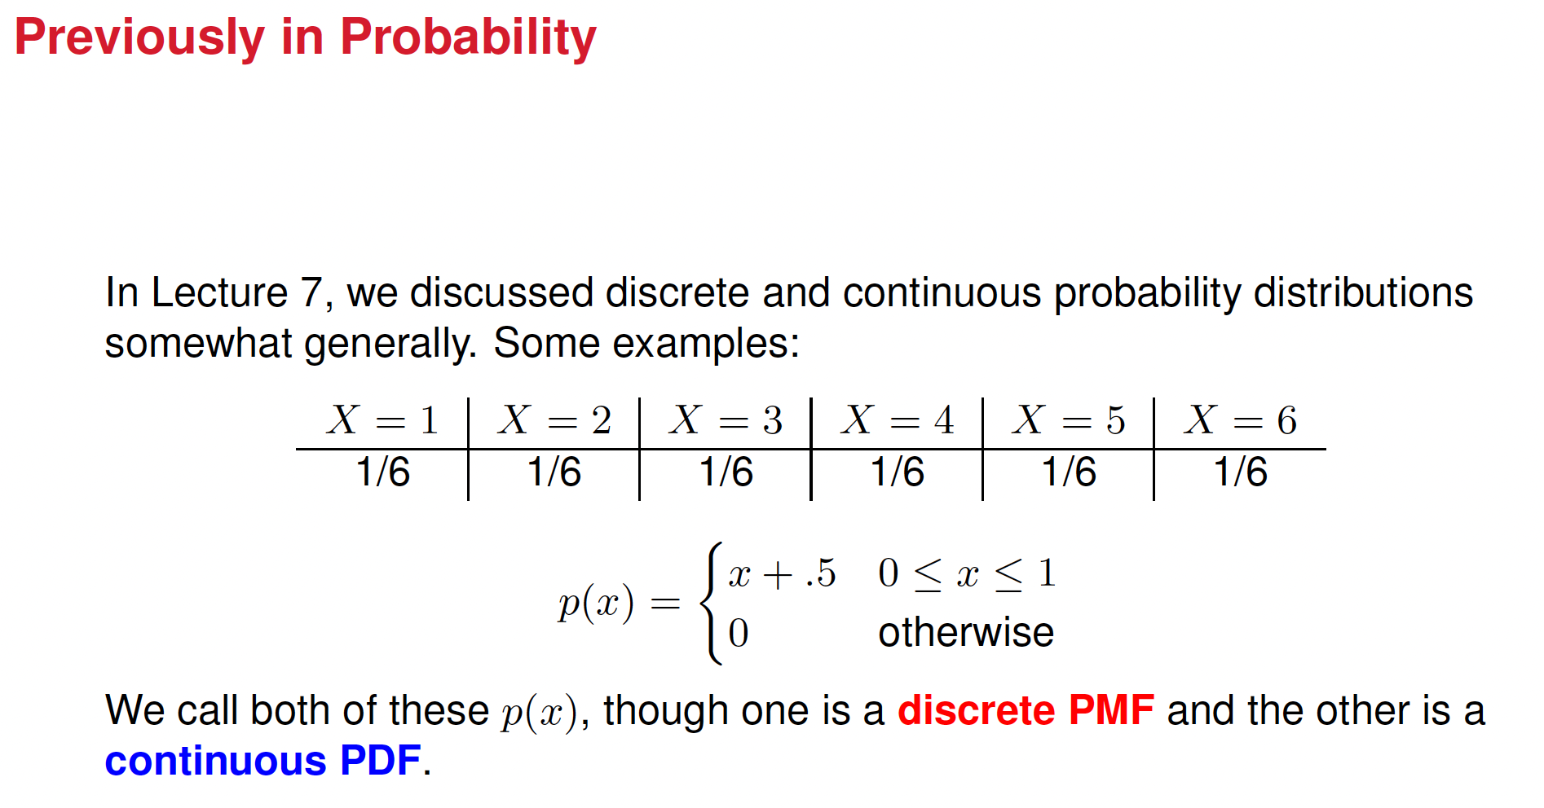

Slide 5
Common Distributions
What follows is a run down of several of the most common (and simple) probability distributions
1 Bernoulli
2 Categorical
3 Uniform (Discrete)
4 Poisson
5 Uniform (Continuous)
6 Exponential
7 Gaussian

Slide 6
Bernoulli & Categorical variable Bernoulli & Categorical trials
Bernoulli Variable: A random variable with two possible outcomes, 1 (Success) or 0 (Failure).
Bernoulli Trials & Distribution: Repeated independent Bernoulli trials lead to a Bernoulli distribution, where the probability of success is θ.
Categorical Variable: A random variable that can take one of k possible outcomes, each with probability θ_{k}.
Categorical Trials & Distribution: Repeated categorical trials form a categorical distribution, where each category has its own probability.

Slide 7
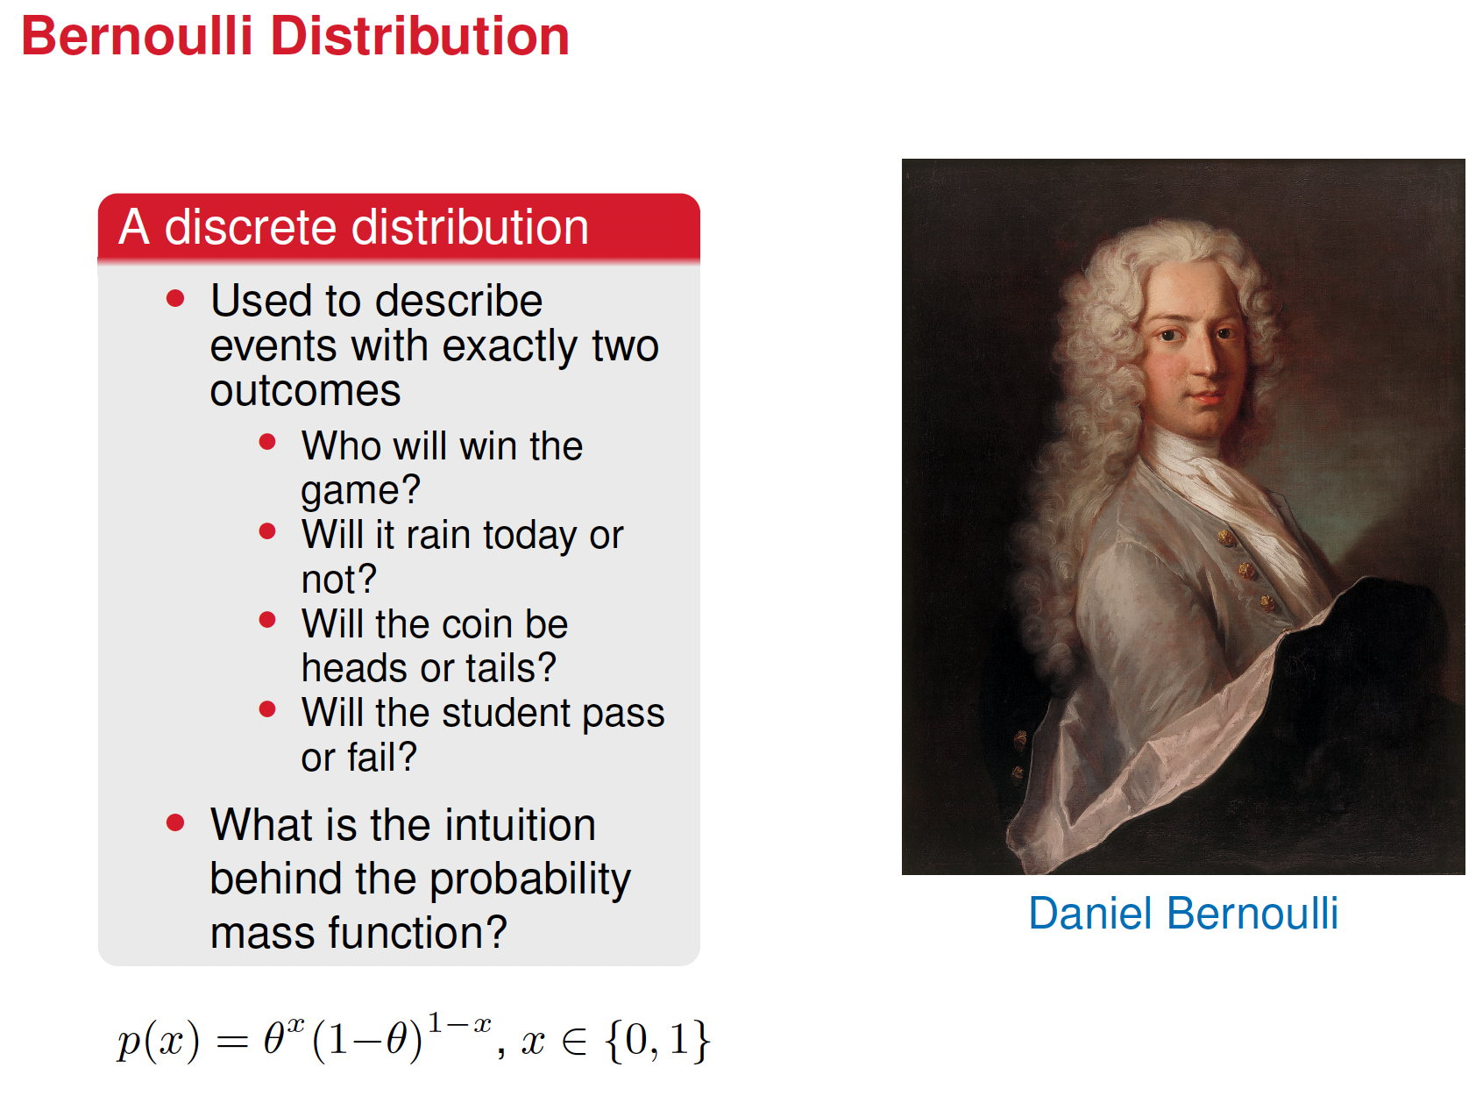

Slide 8
Understanding the Equation
p(x) = θ^{x} (1−θ)^{1−x}, x∈{0,1}
x is a binary random variable that can take values 0 or 1.
Θ is the probability of success (i.e., the probability that x =1), with 0 ≤ θ ≤ 1
1−θ is the probability of failure (i.e., the probability that x = 0)

Slide 9
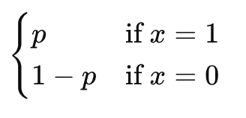








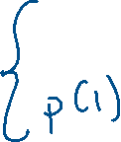













Probability Mass Function, PMF, of a Bernoulli variable
For a Bernoulli variable, PMF = P (X = x) =

Slide 10
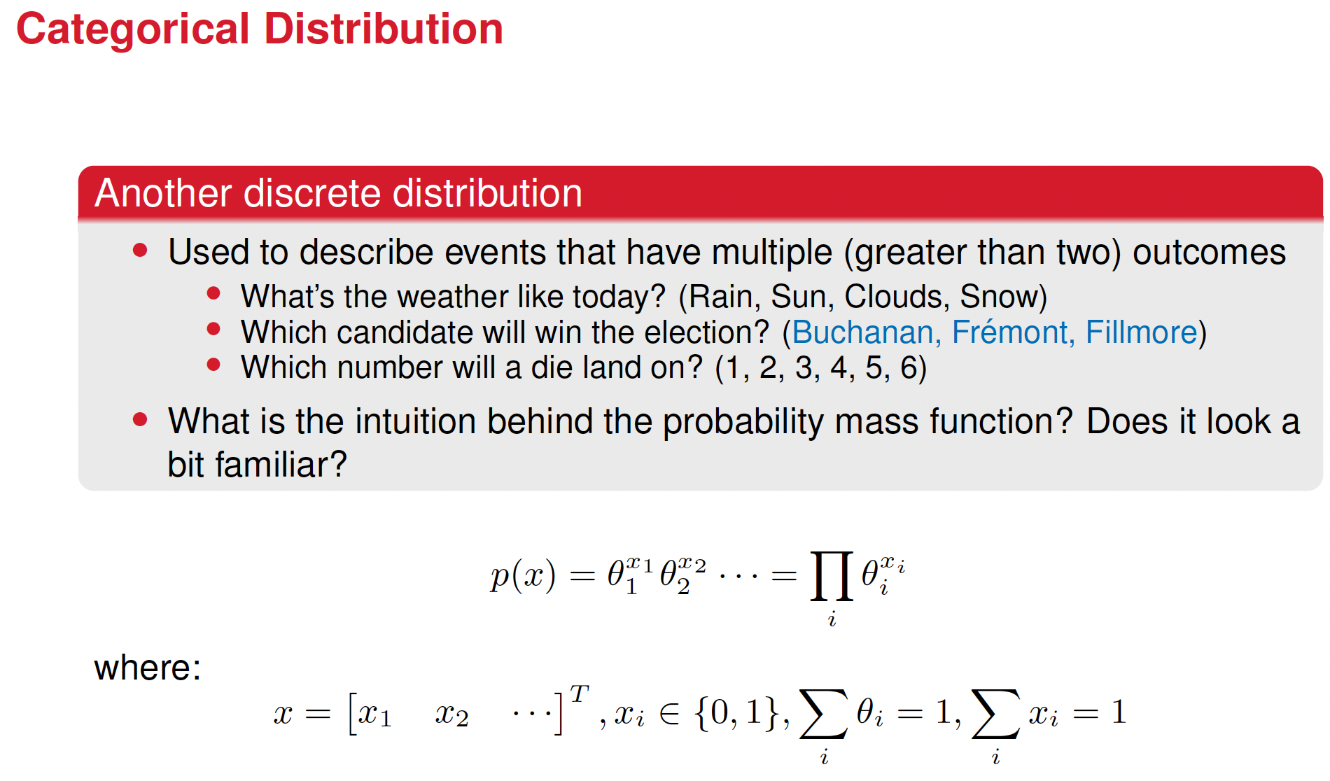


Slide 11
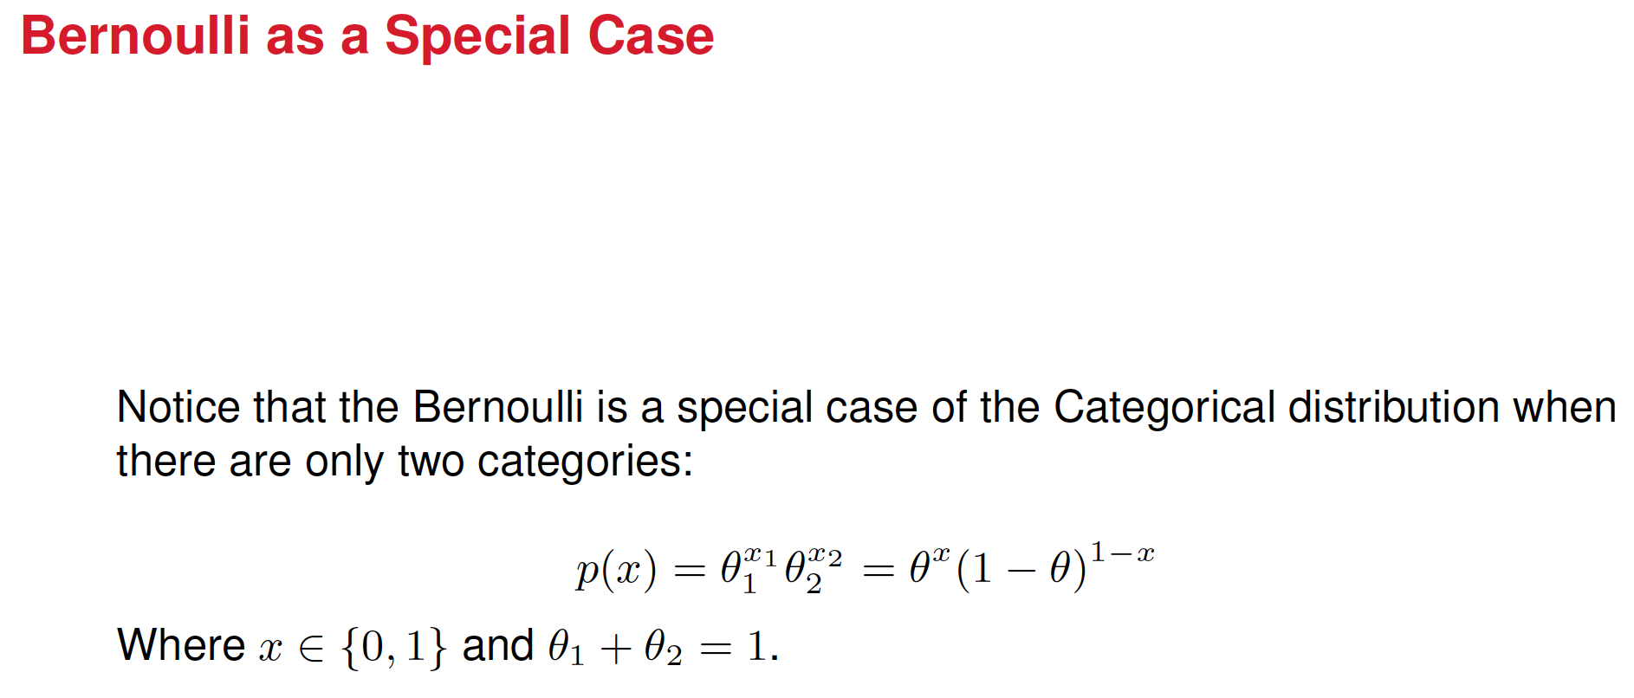

Slide 12
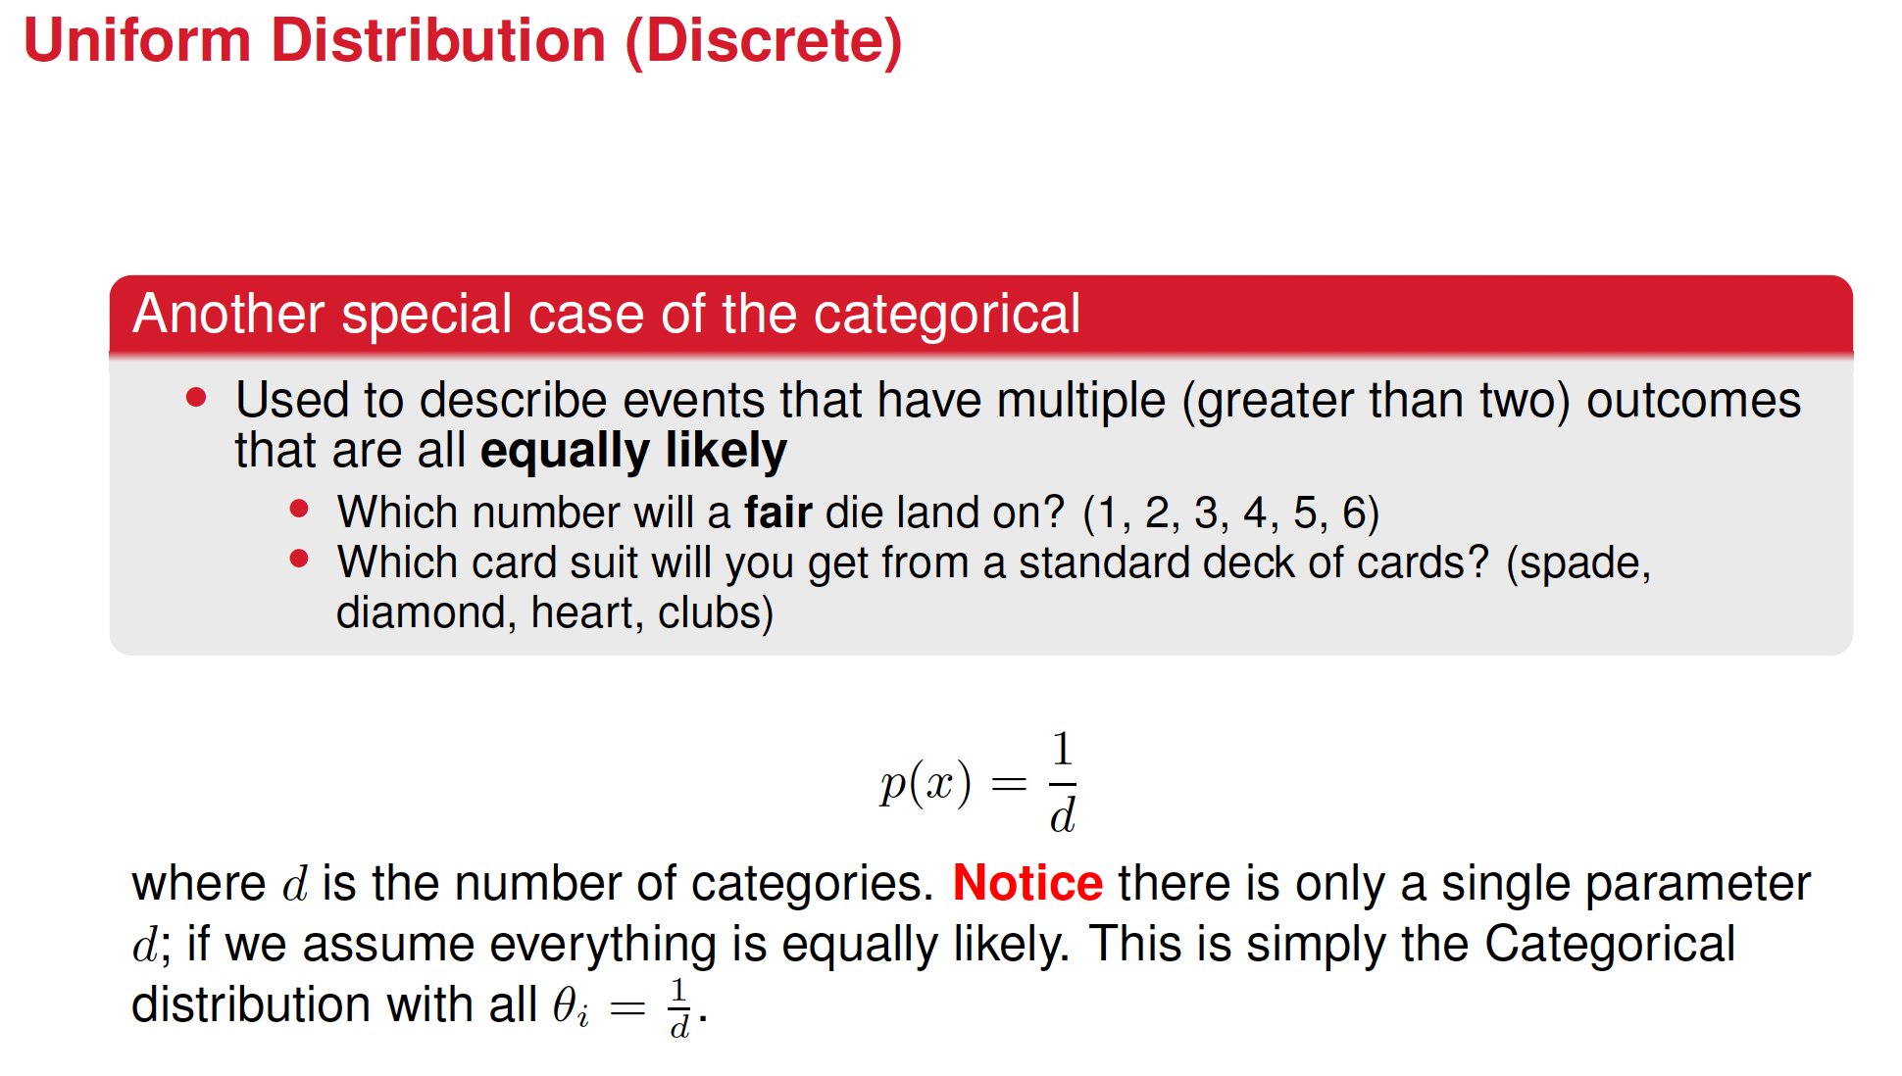


Slide 13
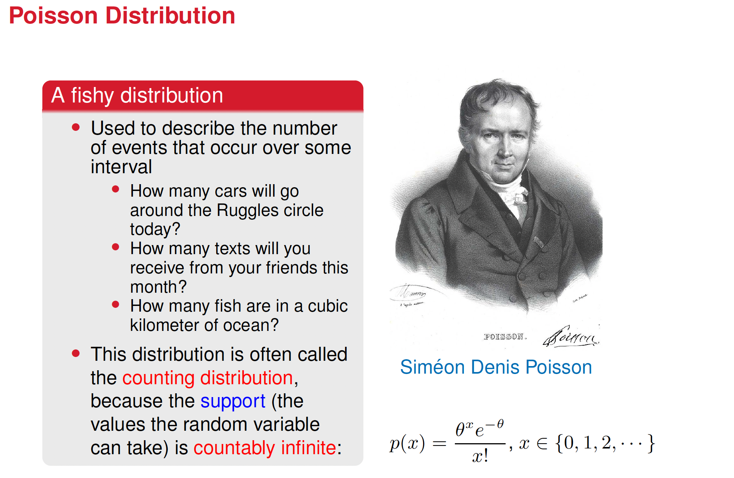
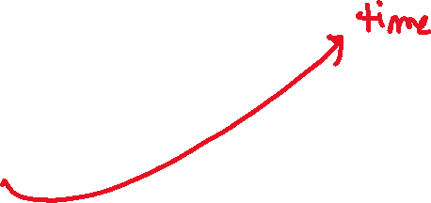




Slide 14
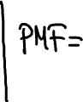
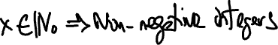

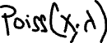

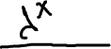

The Poisson distribution
Describes the number of events that occur in a fixed interval of time or space, assuming that events occur independently of each other.
e =2.71828
x is the number of events that occur
λ is average number of events in a given interval

Slide 15
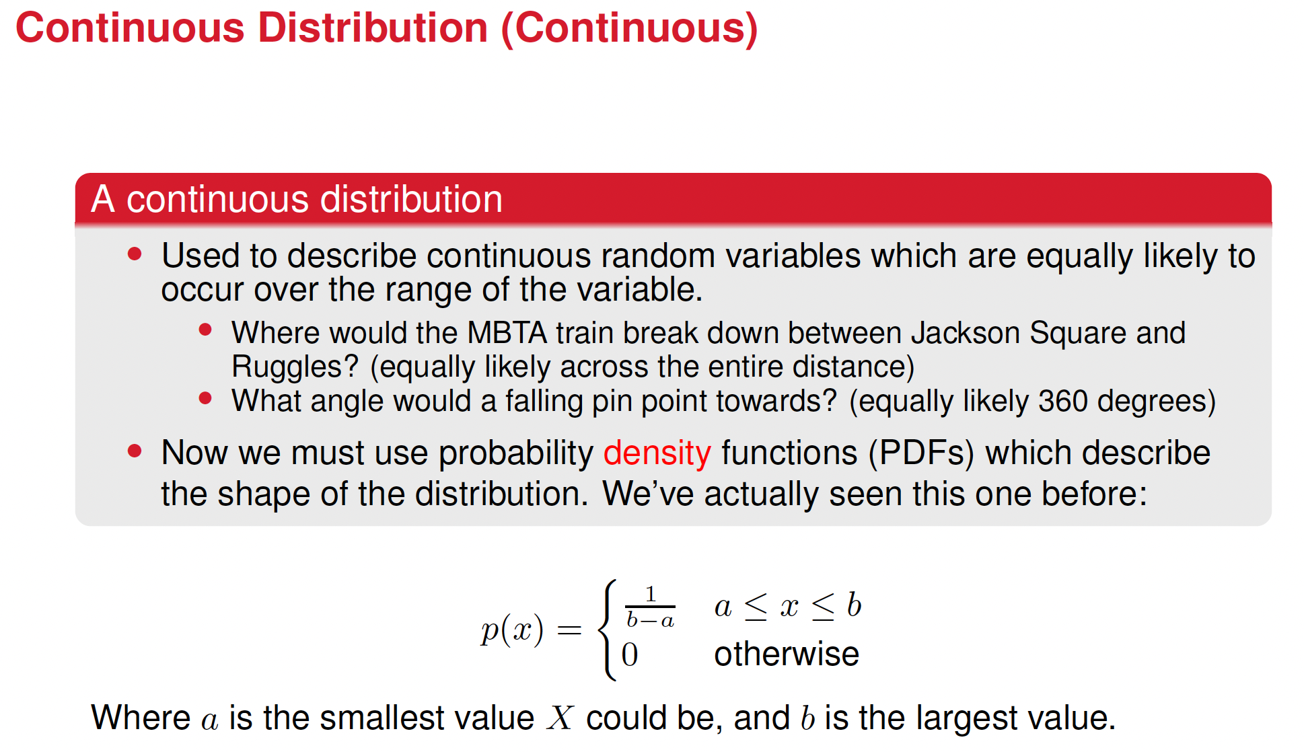






Slide 16
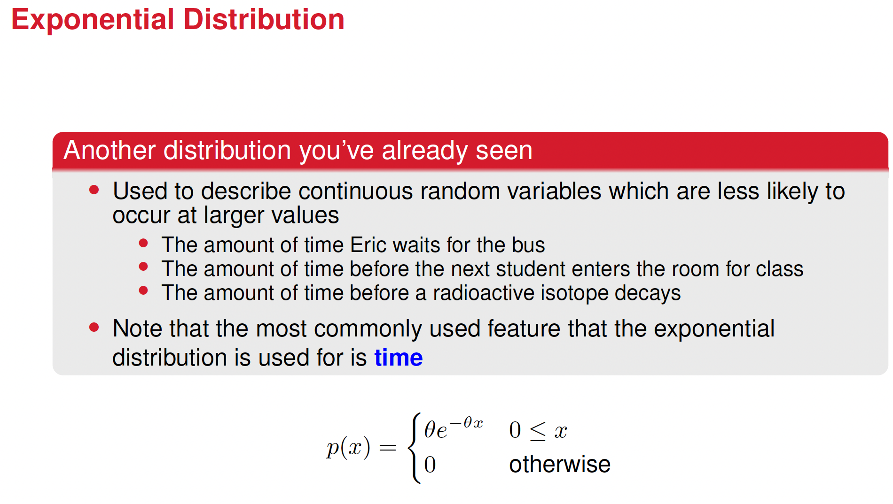



Slide 17
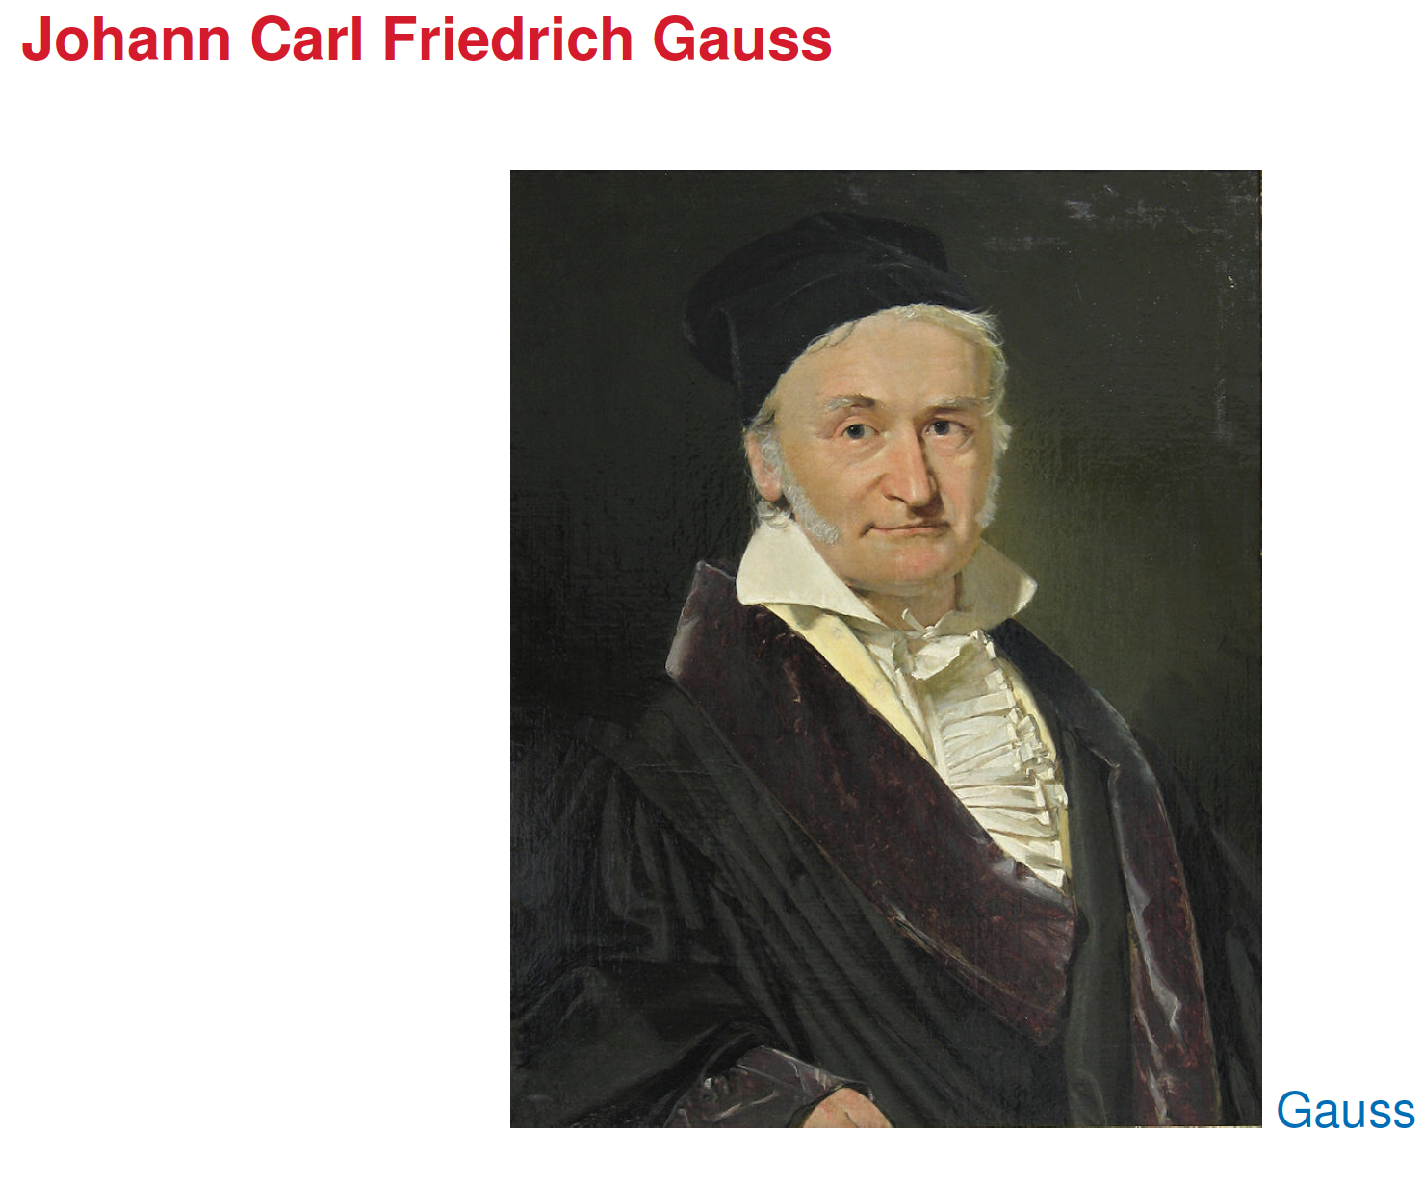

Slide 18
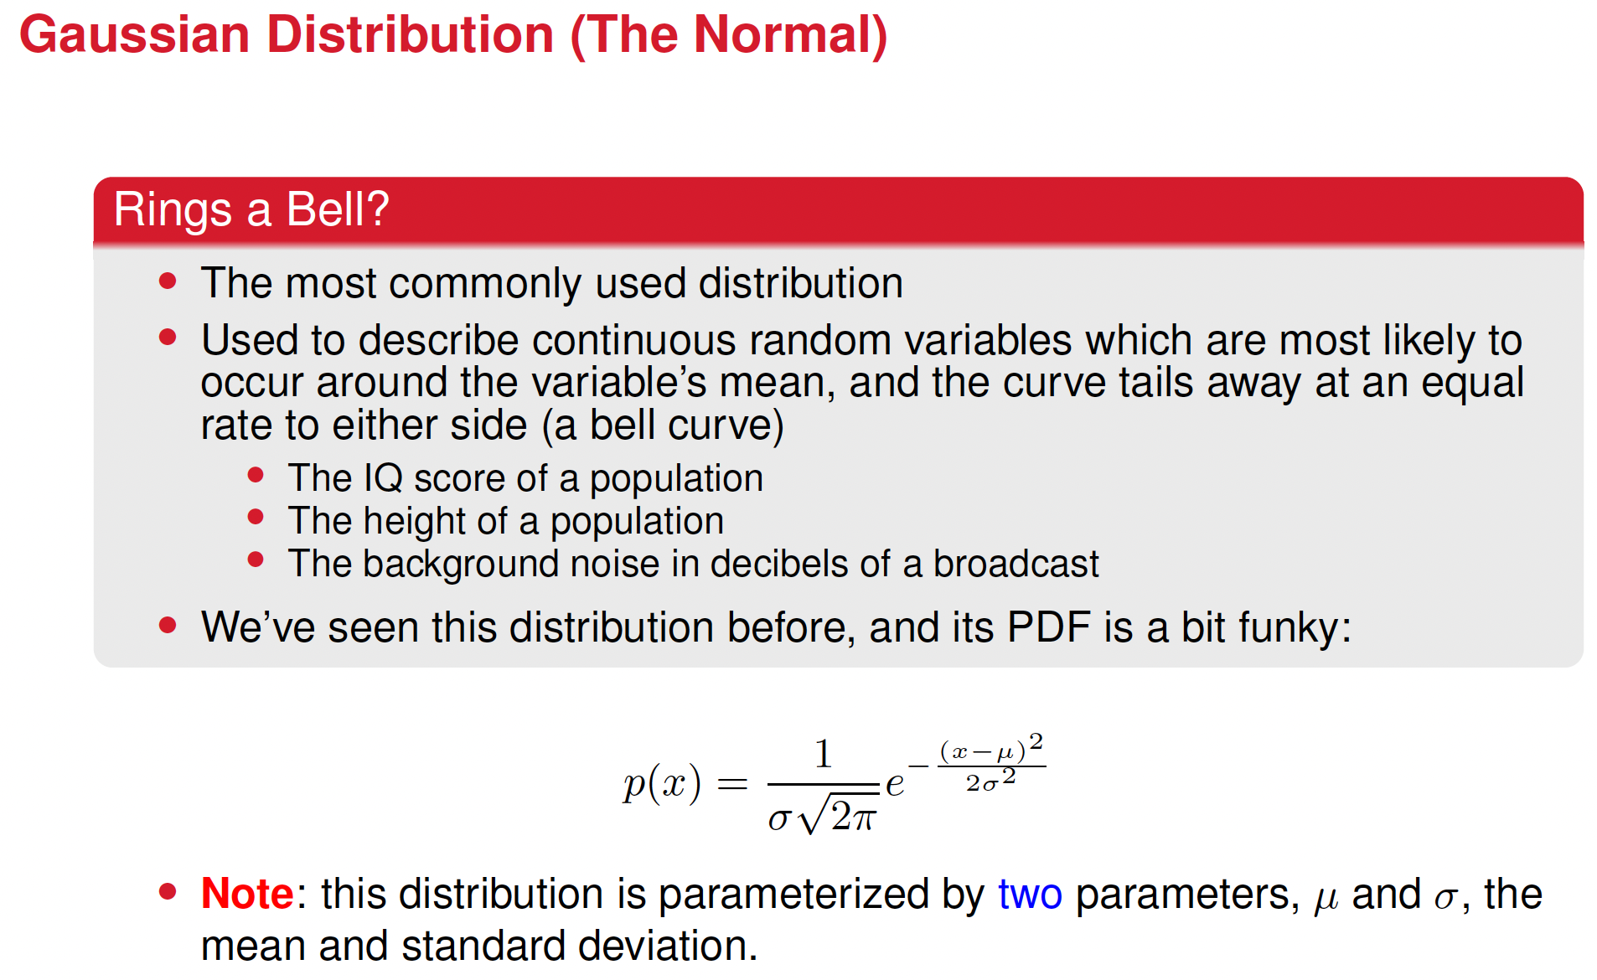





Slide 19
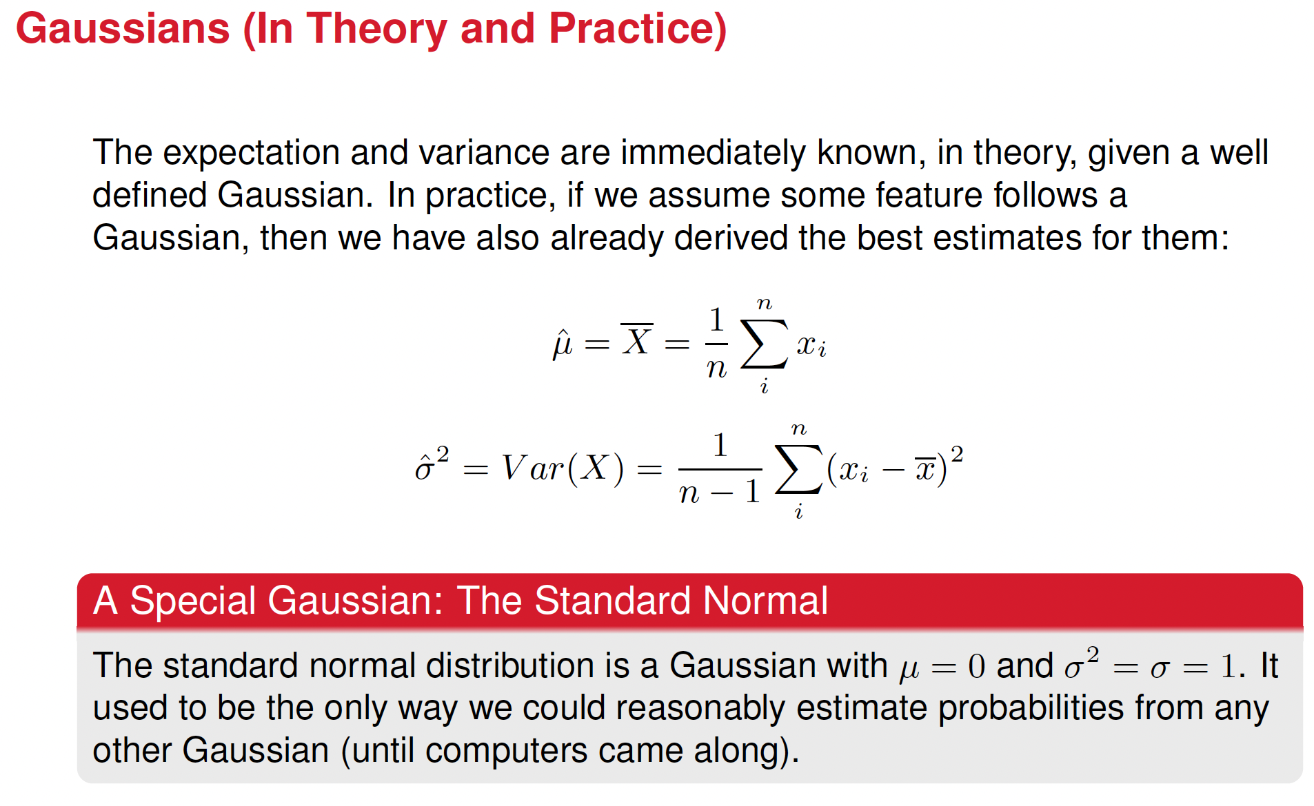










Slide 20
Previously in Probability
Last lecture, we discussed several discrete and continuous distributions, and how they might be used to model real data.
1 Bernoulli
2 Categorical
3 Uniform (Discrete)
4 Poisson
5 Uniform (Continuous)
6 Exponential
7 Gaussian

Slide 21
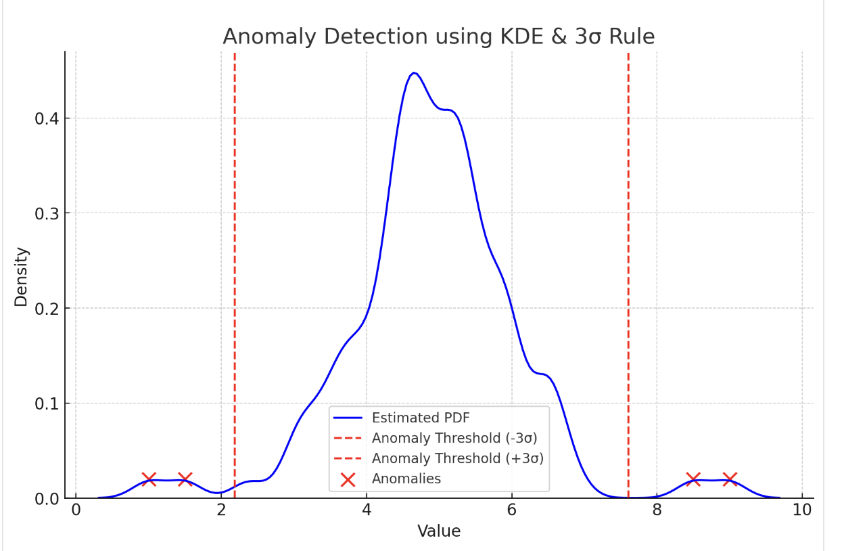
An example of why it’s important to know what PDF approximates certain data
Anomaly Detection
In fraud detection, medical diagnosis, and cybersecurity, anomalies are detected by modeling the normal PDF of data.
If a new data point has a very low probability under the learned PDF, it may be an anomaly.
Example:
If transactions usually follow a log-normal distribution, a sudden transaction in a region of low probability may indicate fraud.
Knowing the PDF allows anomaly detection based on probability density.

Slide 22
Today we’re going to learn methods for estimating probability
distributions, PDF
Maximum Likelihood Estimation, MLE
Kernel Density Estimation, KDE.

Slide 23
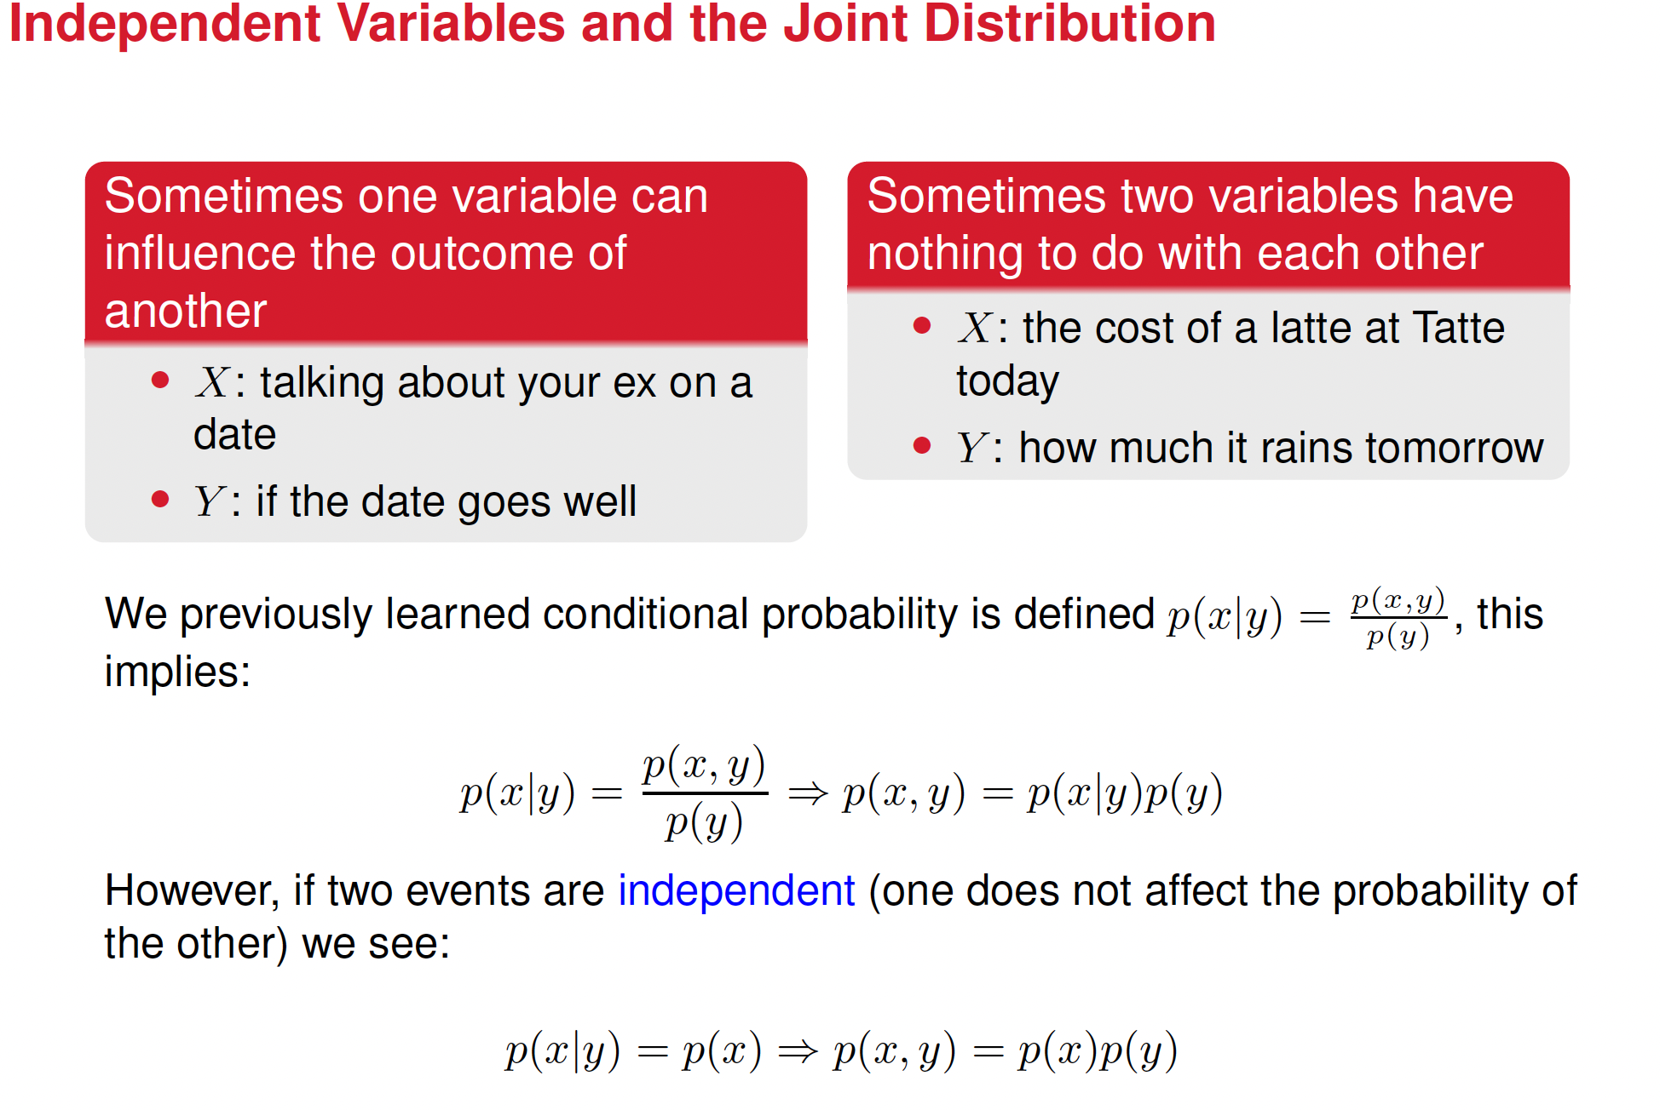

Slide 24
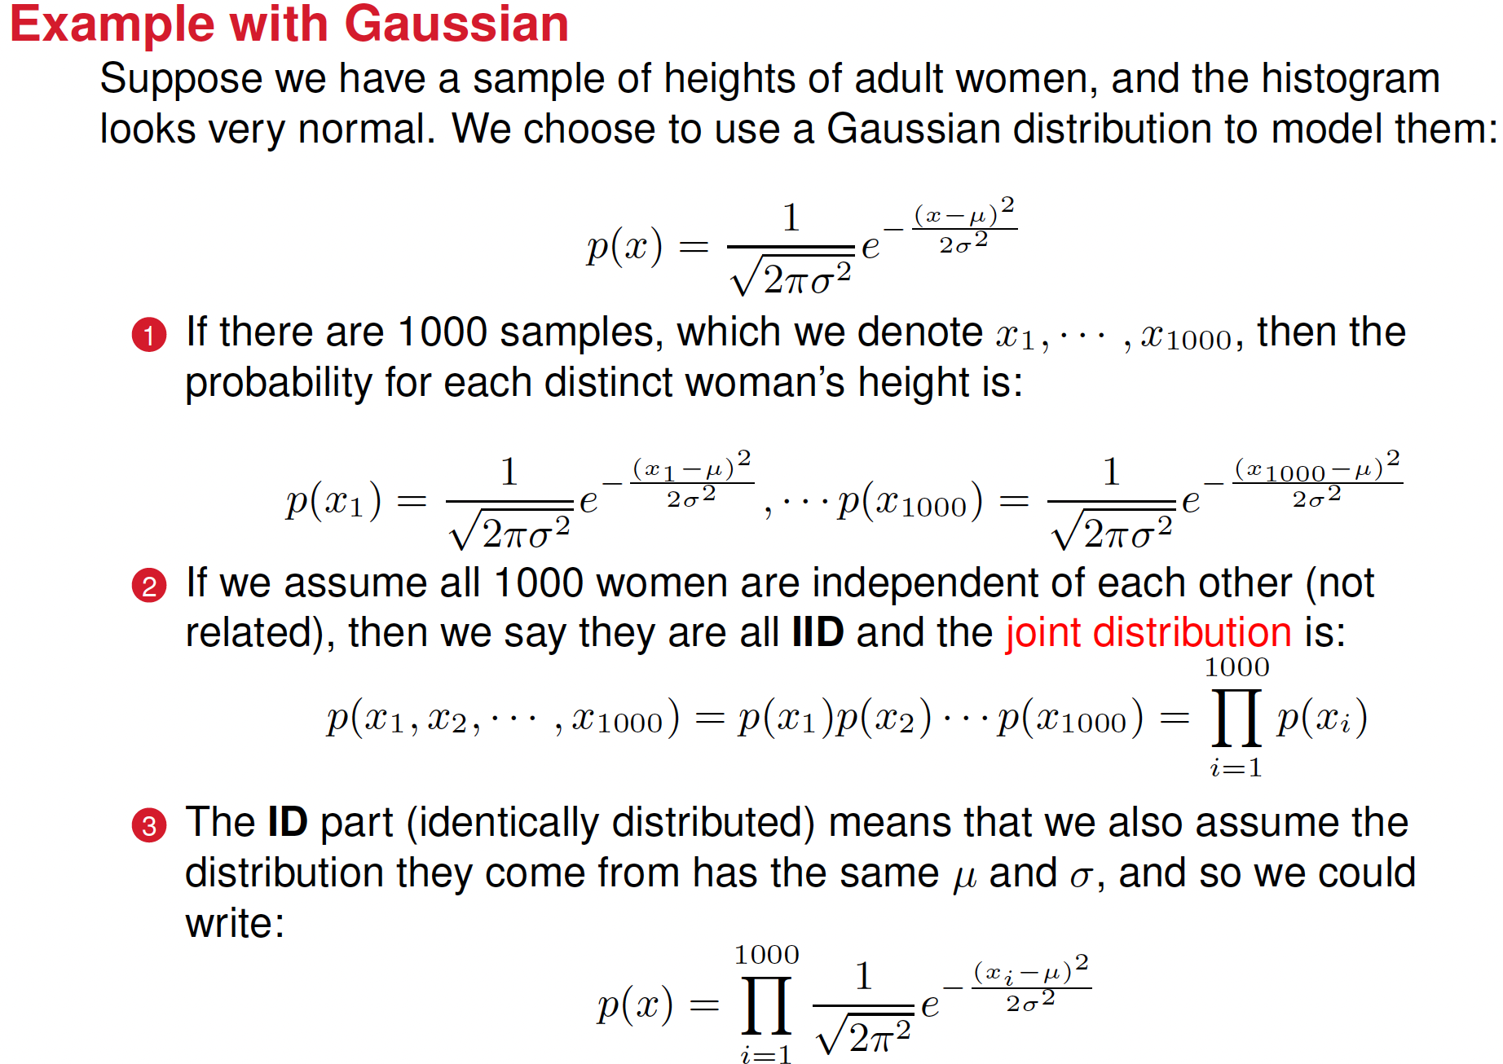

Slide 25
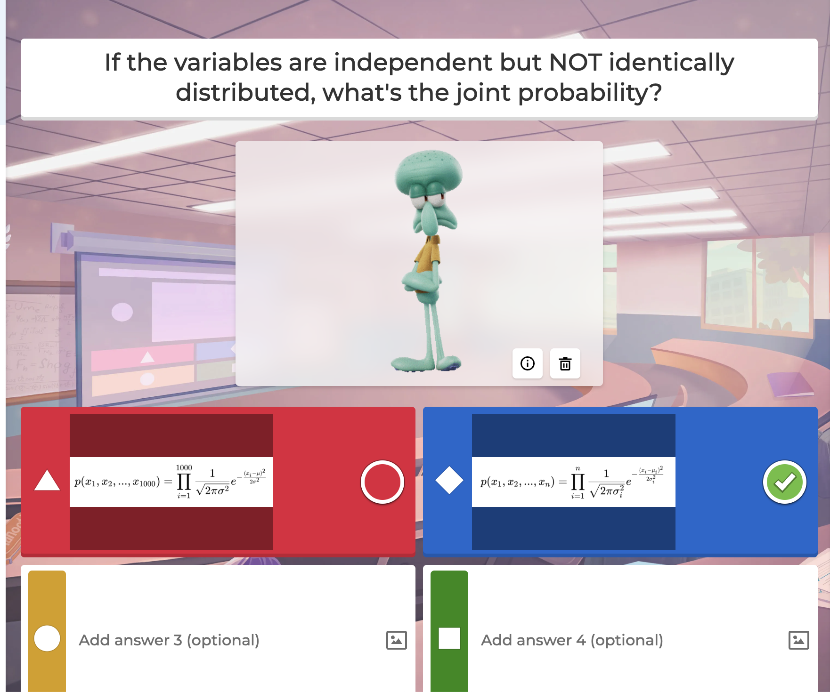

Slide 26
Probability vs. Likelihood in a Gaussian Context
Understanding the key differences in statistical modeling

Slide 27
Key Differences: Probability vs. Likelihood
1. Probability (P(X | μ, σ)):
- Parameters (μ, σ) are known.
- We compute how likely the data X is under these parameters.
- Example: Given μ=165cm, σ=10cm, what is P(X=170)?
2. Likelihood (L(μ, σ | X)):
- Data (X) is fixed, and parameters (μ, σ) are unknown.
- We estimate how plausible different values of (μ, σ) are given X.
- Example: Given X=170cm, how likely is it that μ=165?
Probability answers: "Given parameters, what is the chance of this data?"
Likelihood answers: "Given the data, how plausible are different values of
parameters?"

Slide 28
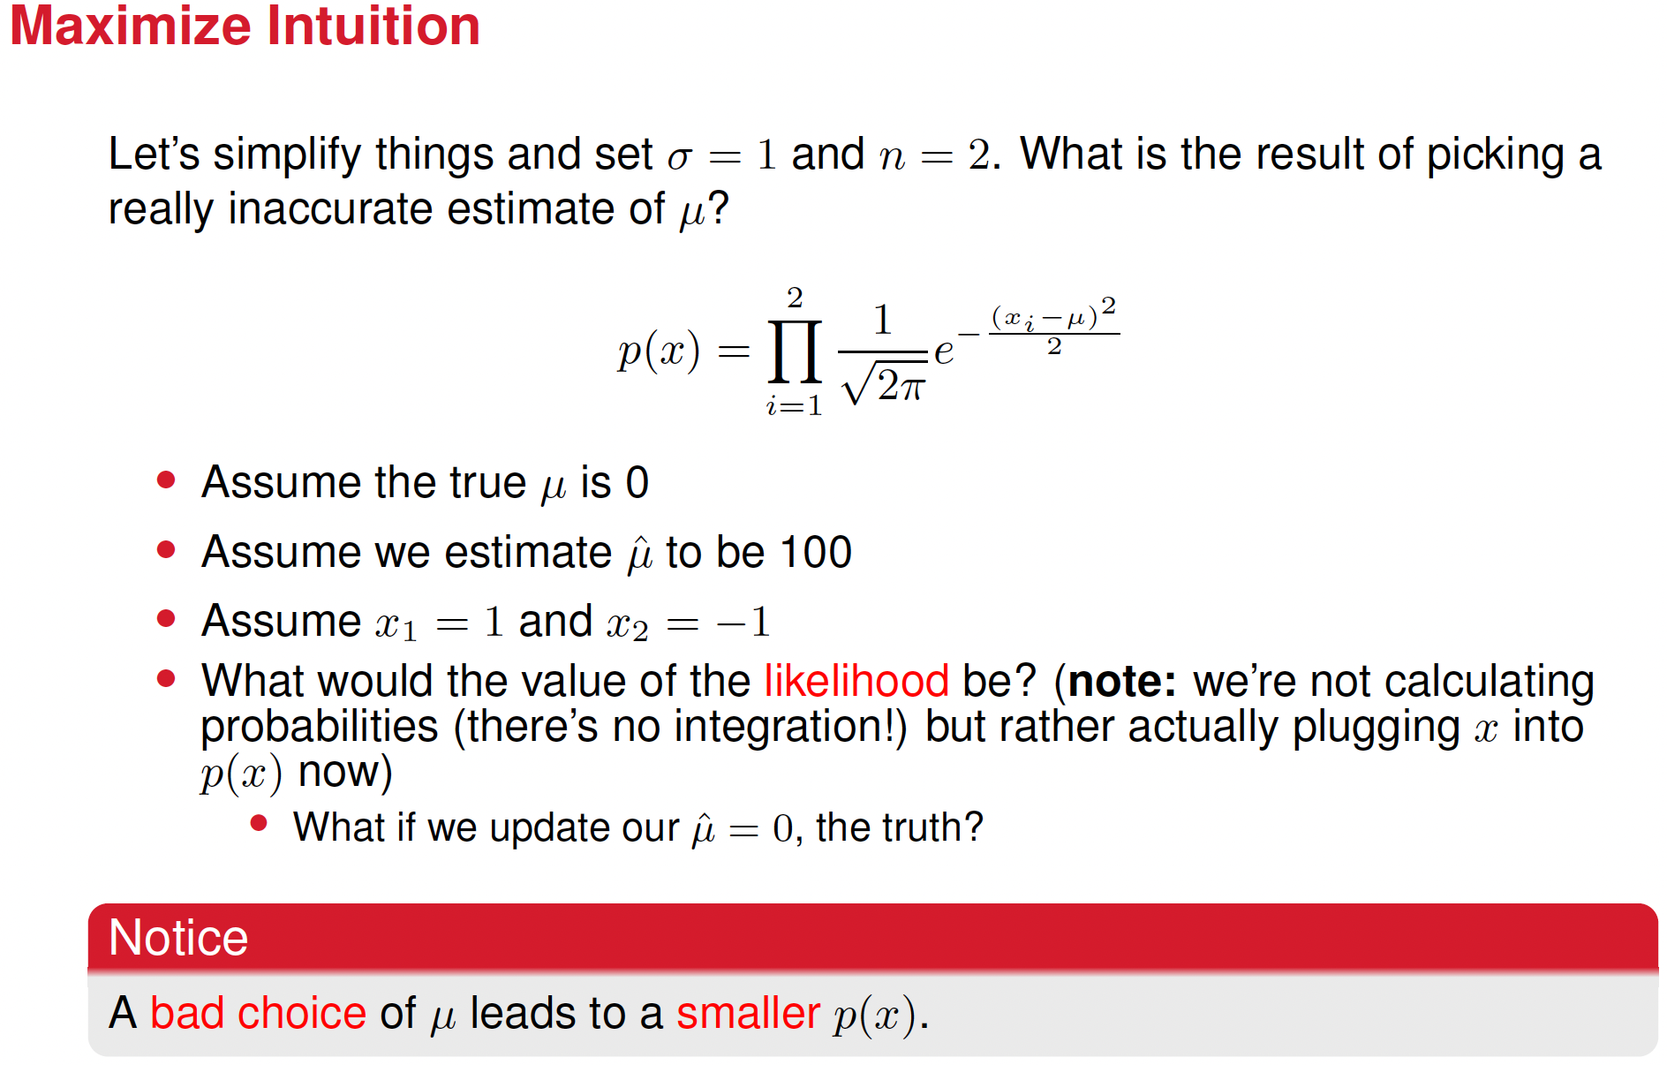

Slide 29


Slide 30
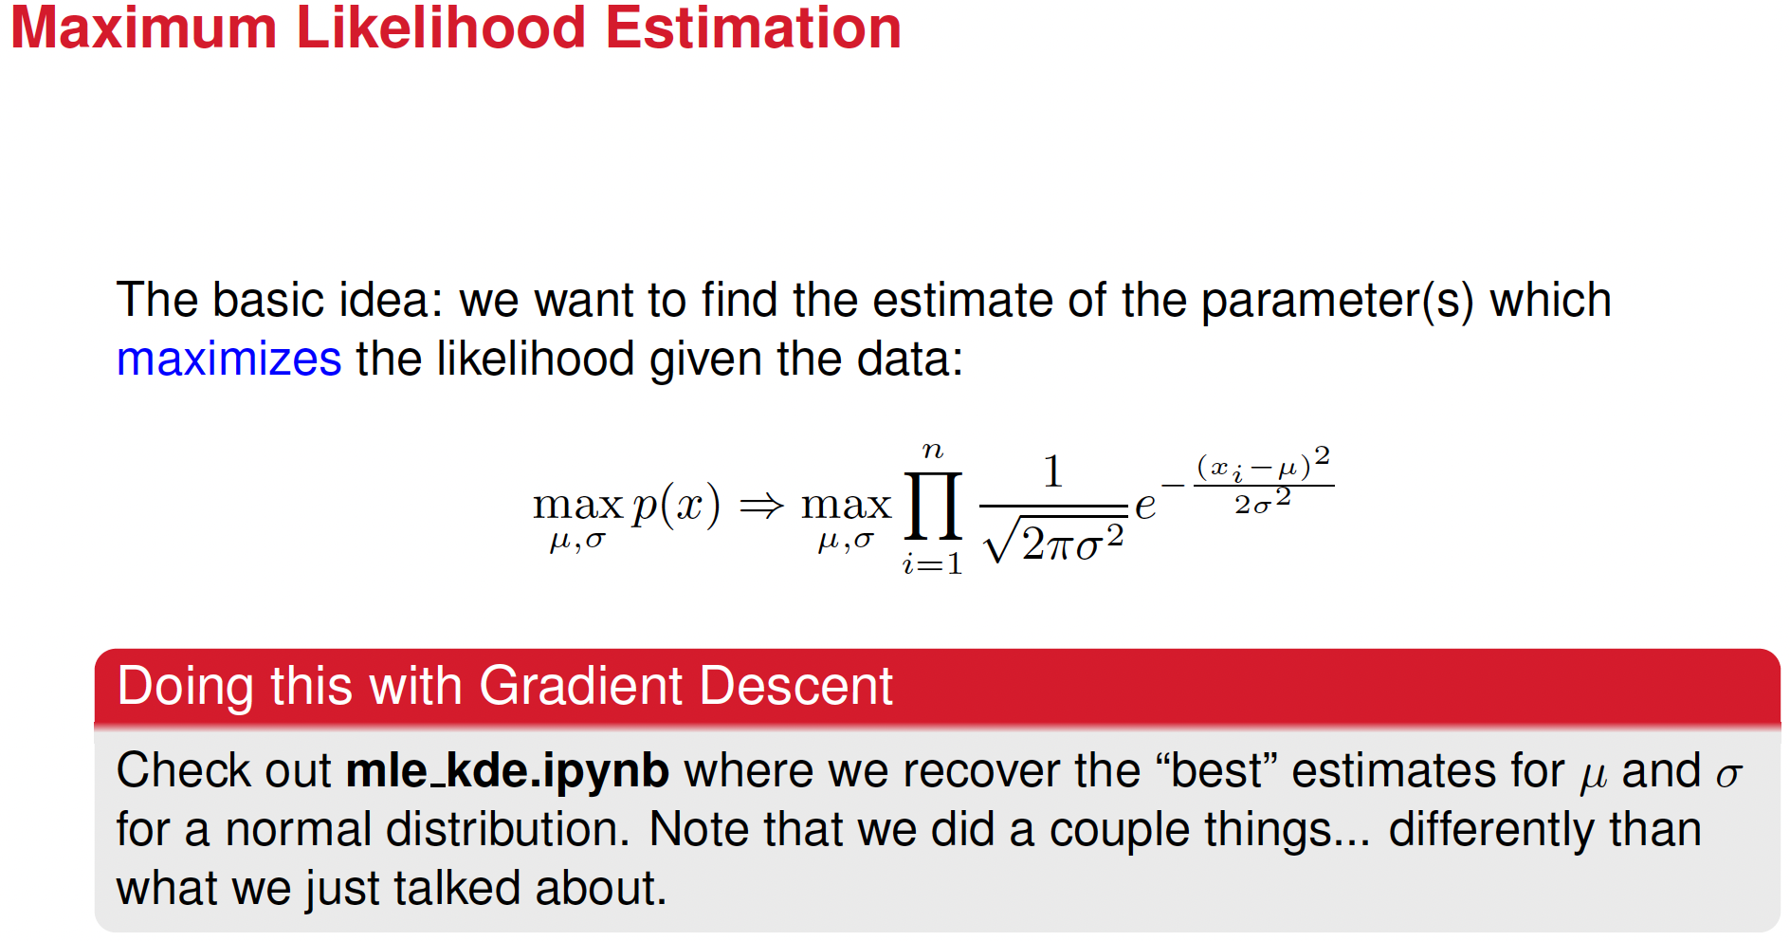


Slide 31
Let’s find the solution analytically (the closed-form solution) instead of using gradient descent

Slide 32
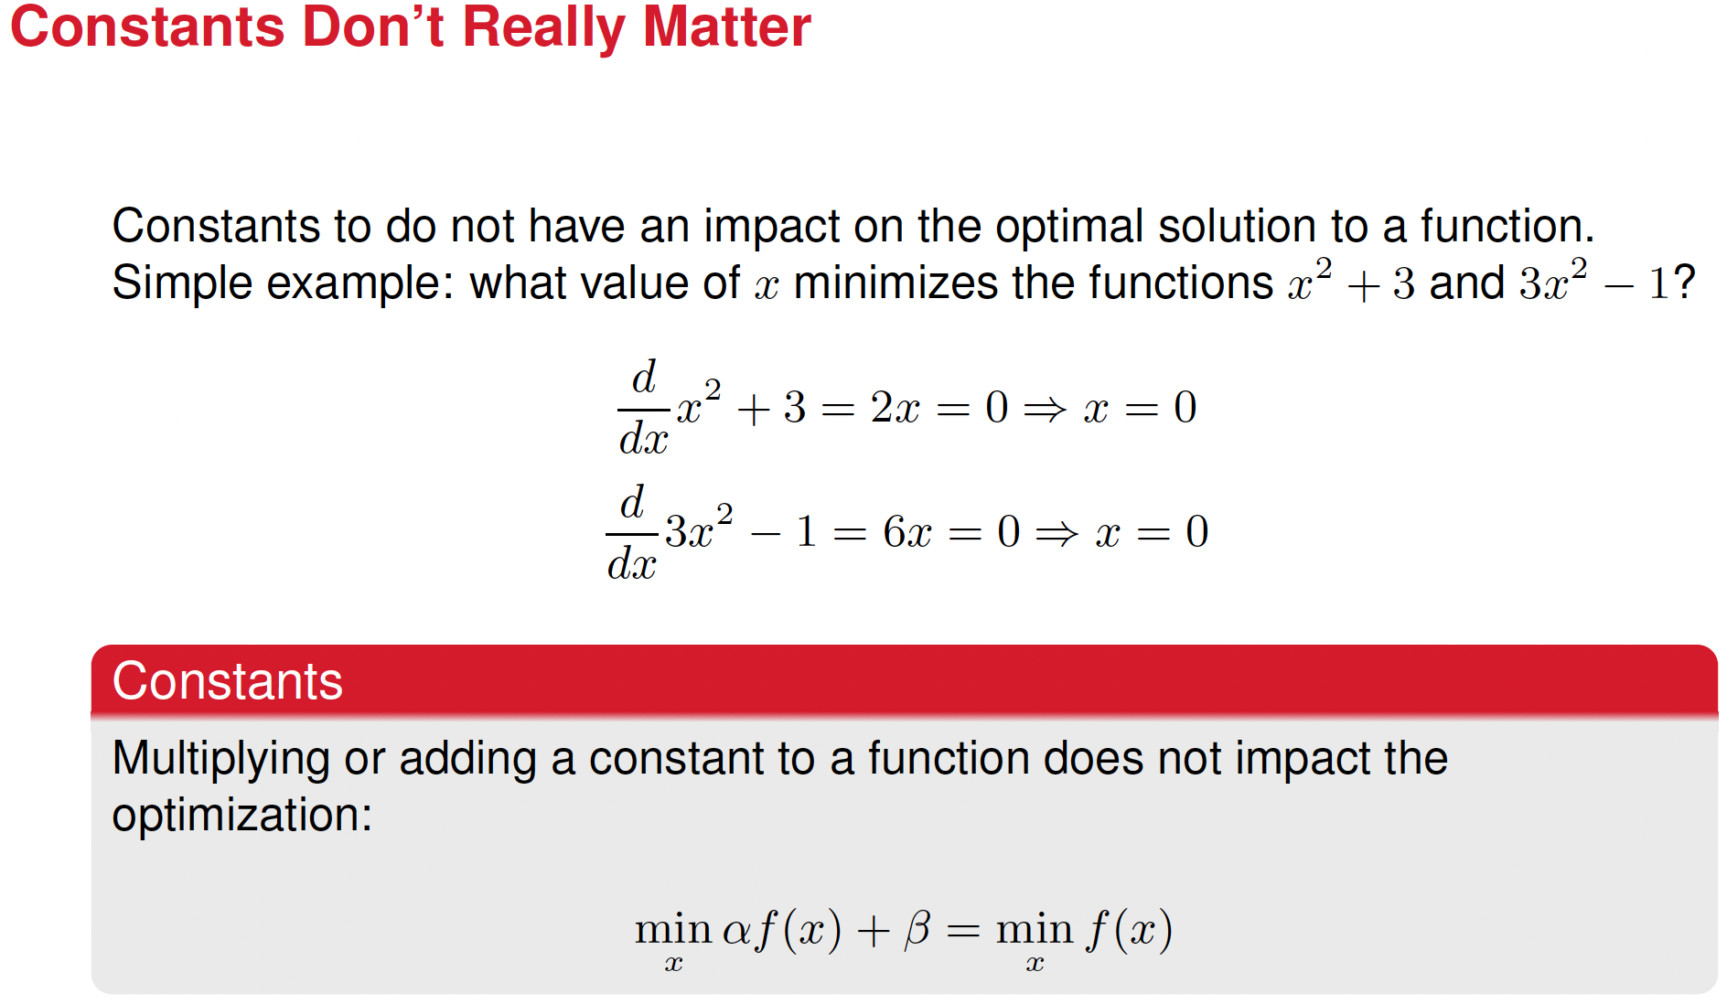





Slide 33
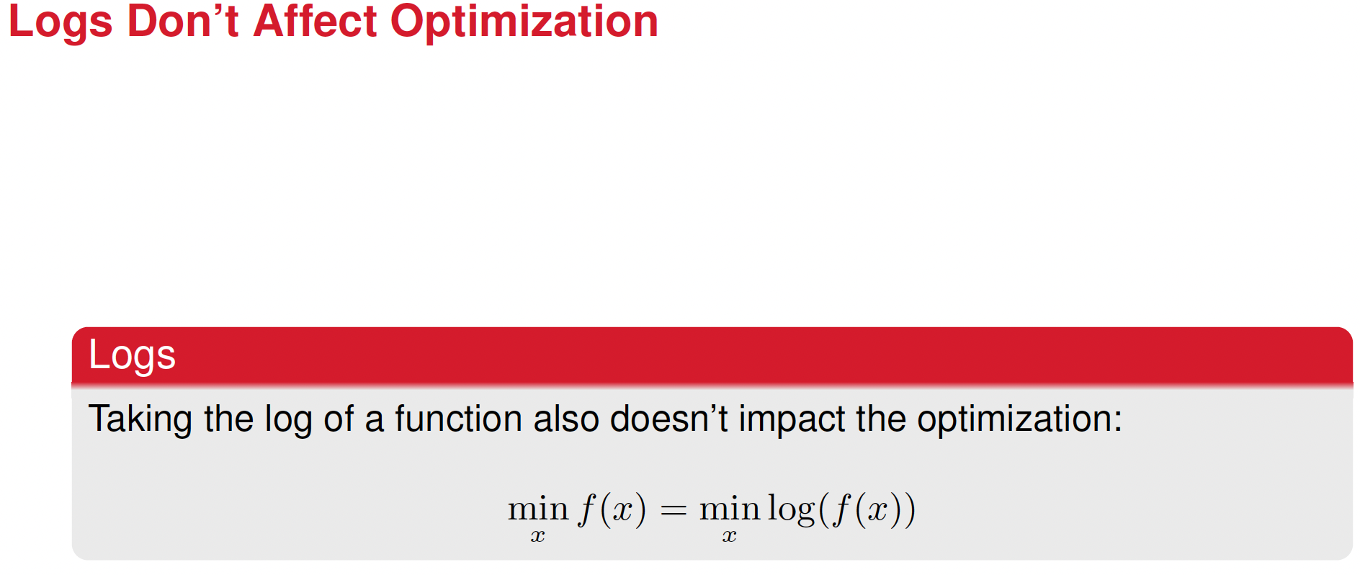
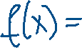



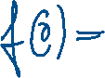

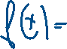











Slide 34
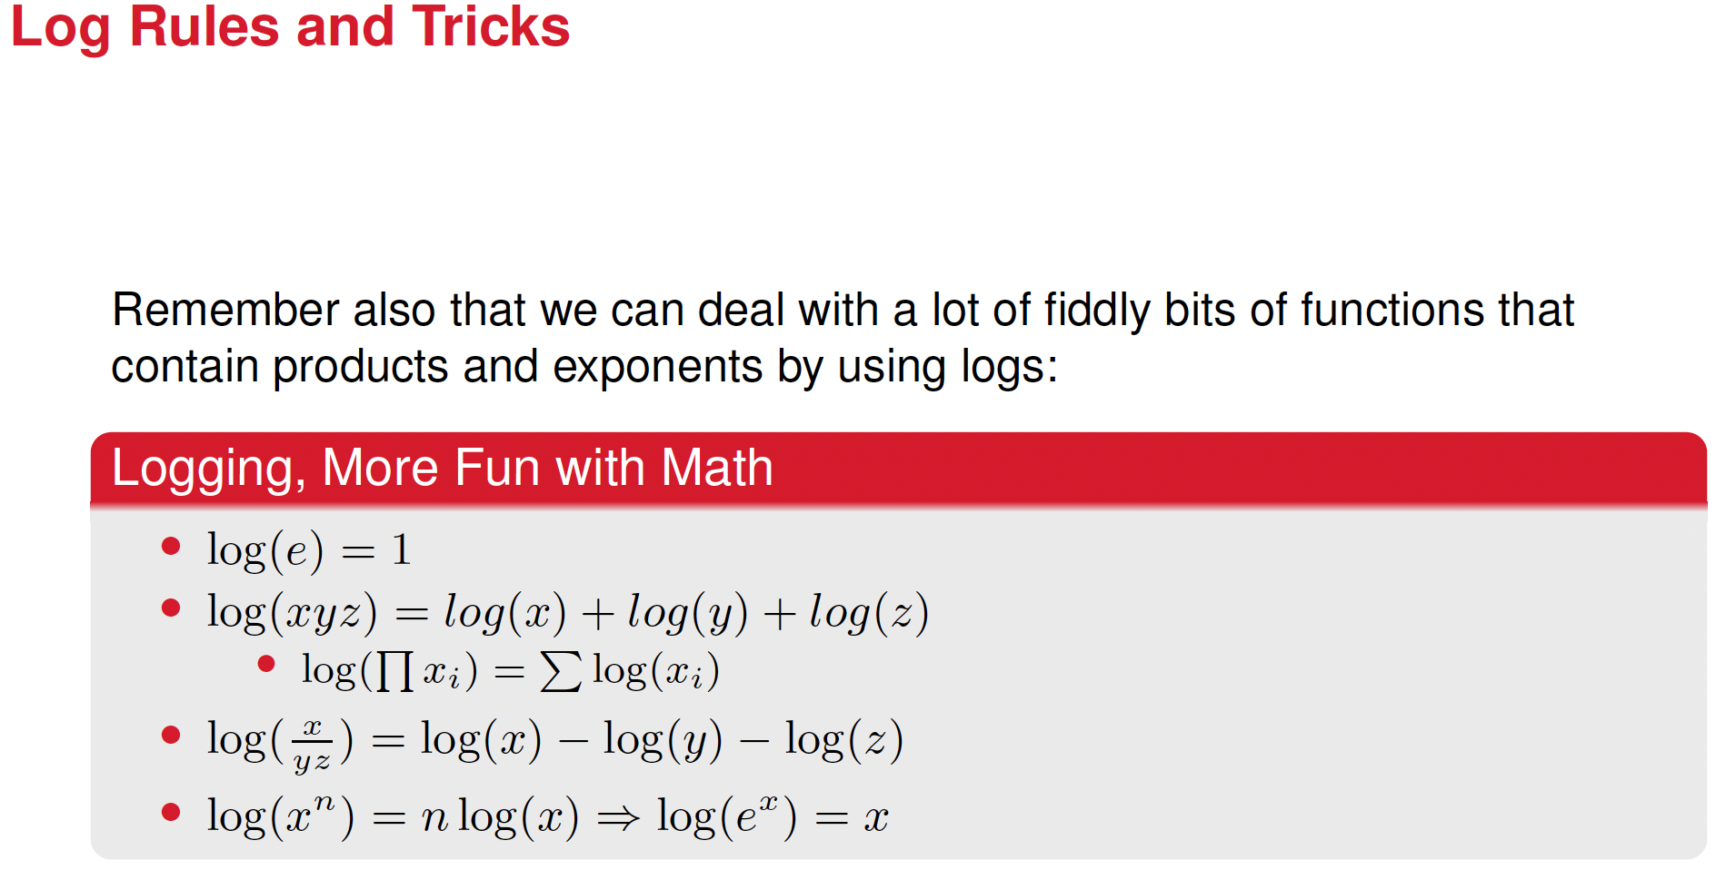





Slide 35
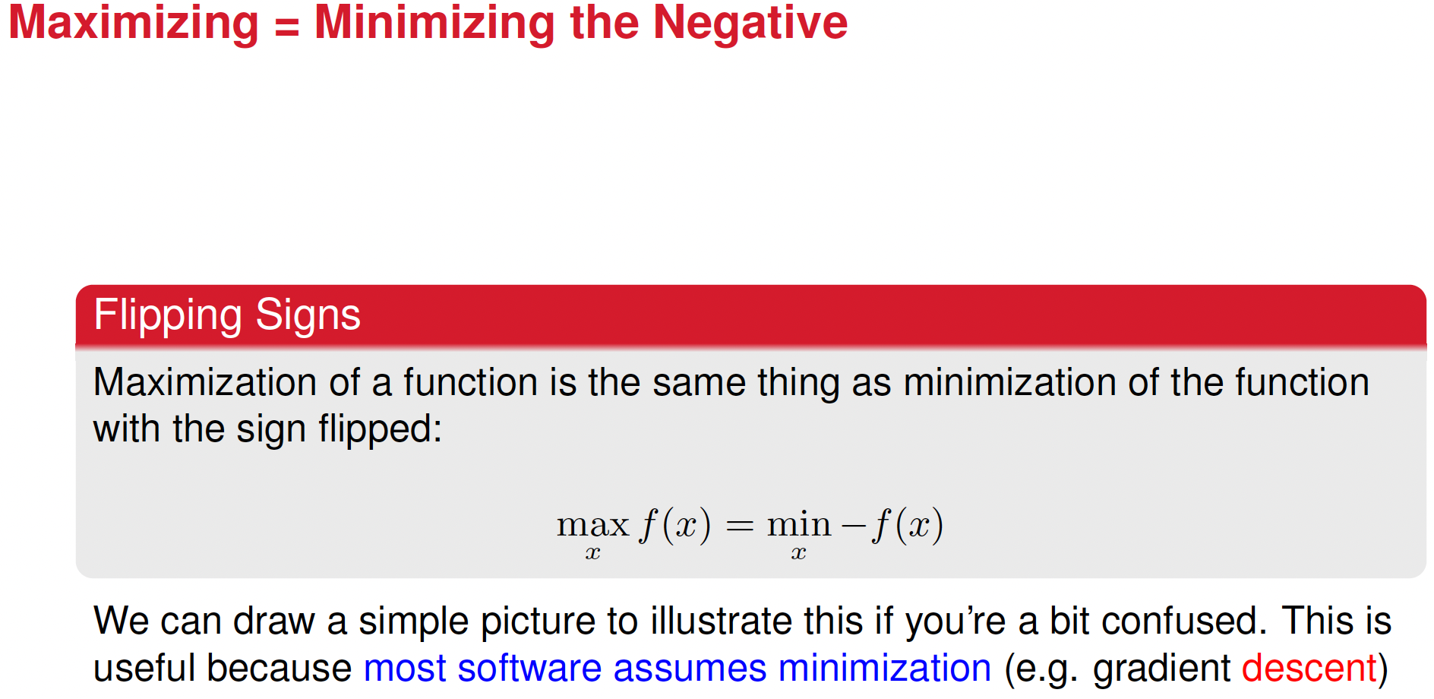

Slide 36
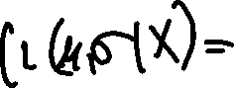
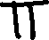
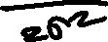

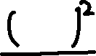




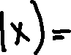
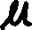
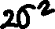



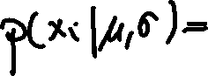
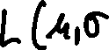

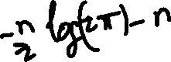
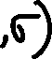
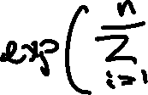


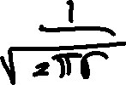

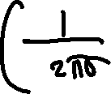
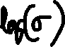



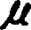


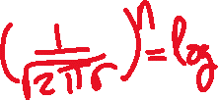
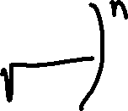
Ok, so now let’s obtain the closed-form solutions for the MLE of the gaussian distribution for independent and equally distributed variables

Slide 37
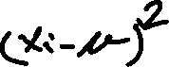


























Slide 38



























Slide 39


Slide 40


Slide 41


Slide 42


Slide 43
Kernel Density Estimation (KDE) vs. Maximum Likelihood Estimation (MLE)
Similarities
Both estimate probability distributions from observed data
Both do not assume the true distribution is known beforehand.
Both are data-driven methods.

Slide 44



Kernel Density Estimation (KDE) vs. Maximum Likelihood Estimation (MLE)
Differences
 | KDE (Kernel Density Estimation) | MLE (Maximum Likelihood Estimation)
Goal | Estimate the probability density function (PDF) in a flexible way | Estimate parameters of a specific probability distribution
Assumption | No assumption about the underlying distribution | Assumes a known parametric form (e.g., normal, exponential)
Method | Uses a kernel function to smooth the distribution | Maximizes the likelihood function to find parameters
Output | A continuous density function estimated from data | A set of parameters (e.g., μ,σ}, for a normal distribution)
When to Use | When we do not know the true distribution | When we assume a specific distribution and need parameters

Slide 45


Slide 46



Choosing h (the bandwidth) using the standard deviation of the sample. This method
Is called the Silverman’s rule

Slide 47


Slide 48


